Slide 1
PRESENT SIMPLE:
to be / to have got

Slide 2
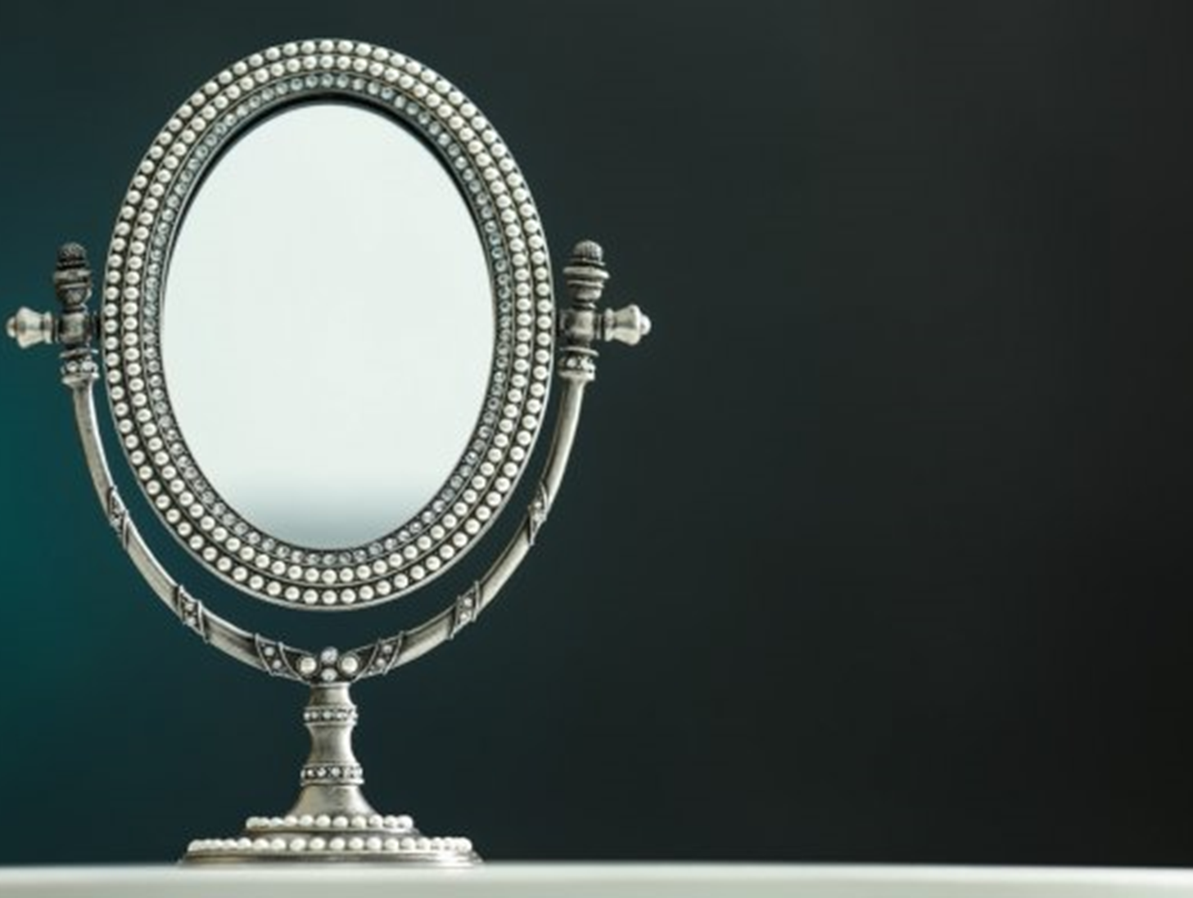
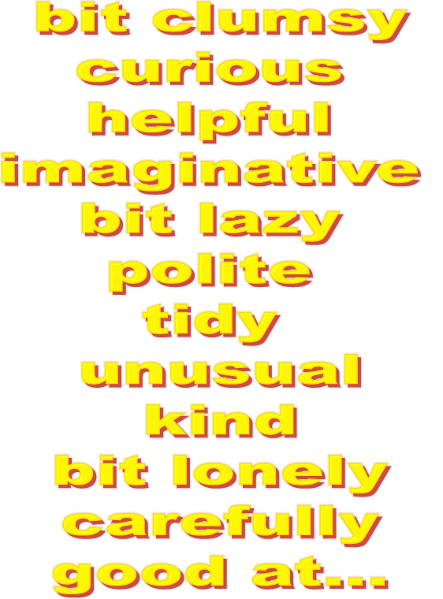
He is...
She is...

Slide 3
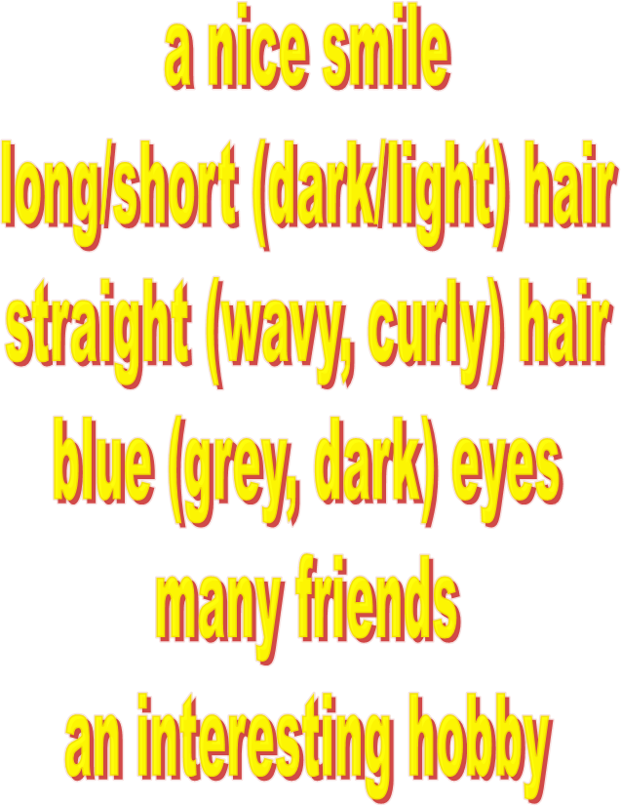
He
She
has got...

